Slide 1
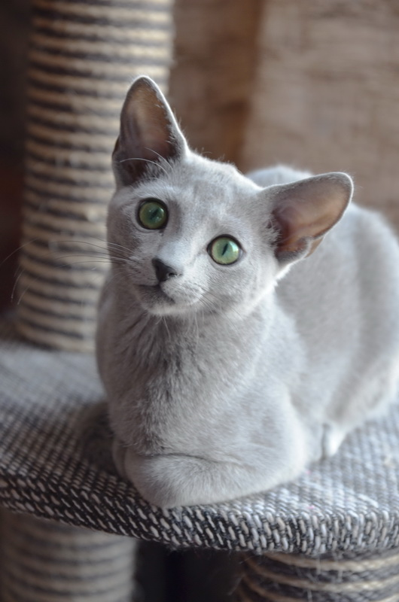
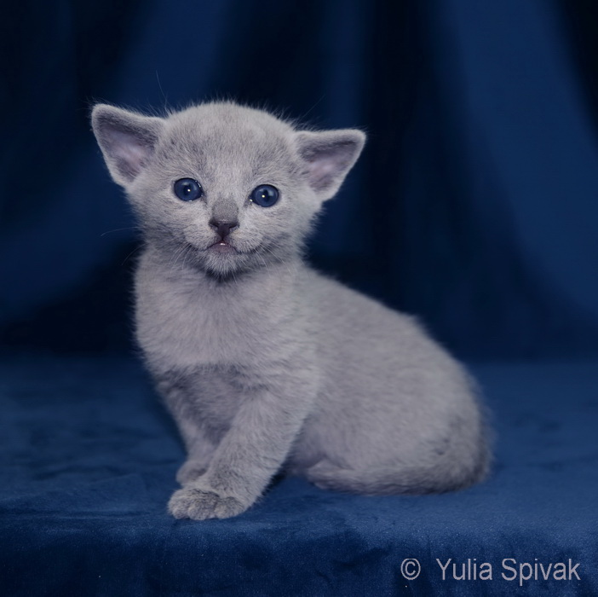
The Russian Blue
… an illustration of the
CCA standard

Slide 2
GENERAL: the good show specimen has good physical condition, is firm in muscle tone, and alert.
BODY 15 Points
Body 5
Legs and Feet 5
Tail 5
HEAD 25 Points
Full face 10
Profile 5
Ears 5
Eyes 5
COAT 25 Points
COLOR 30 Points
Coat color 20
Eye color 10
CONDITION and BALANCE 5 Points
OBJECTIONS DEDUCT
• Exaggerated pinch or whisker break 1-3
• Nose break or stop 1-3
• Dull eyes 1-3
• Lusterless coat 1-3
WITHHOLDS
• Lack of green eyes at two years of age
• Nose break or stop
• Lack of undercoat
• All grounds for withholding awards as listed in the General Preface
RECOGNIZED COLOR
• Blue

Slide 3
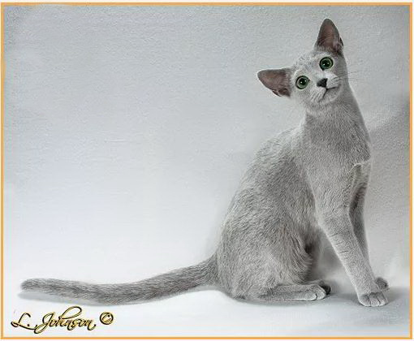
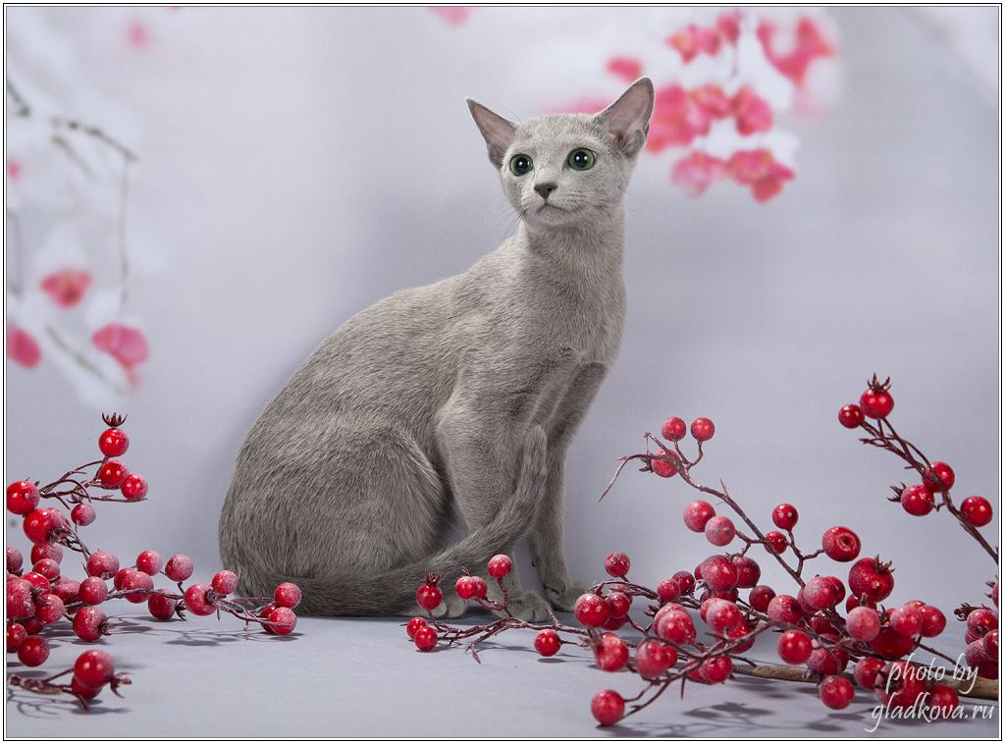
BODY 15 Points
Fine boned, long, firm, and muscular; lithe and graceful in outline and carriage without being tubular in appearance. Heavier in repose due to a supple skin and thick coat

Slide 4
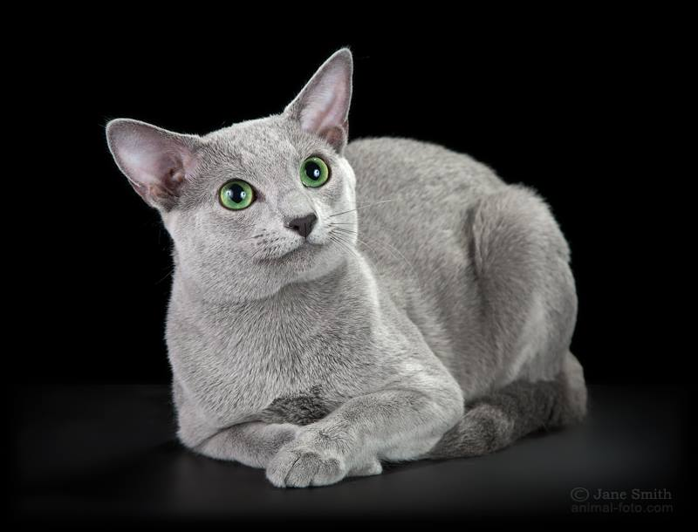
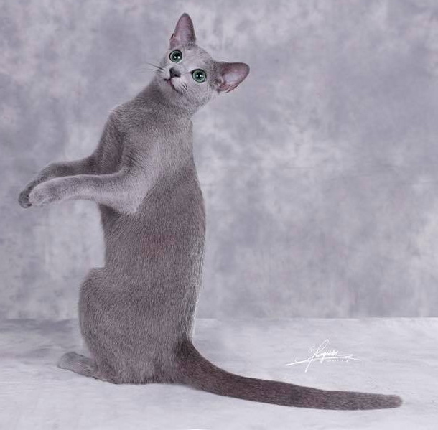
BODY (continued)
Legs and Feet: long and fine boned with small , neat and well rounded feet.
Tail: long and in proportion to the body. Thick at base and tapering.

Slide 5
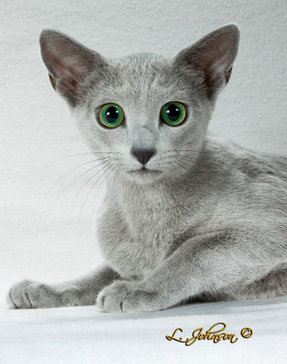
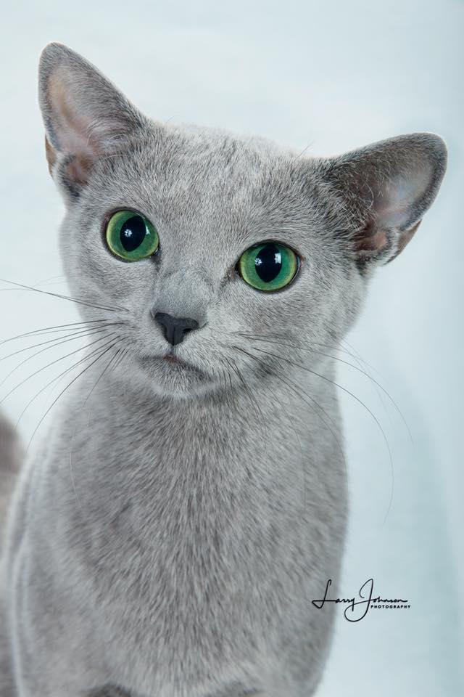
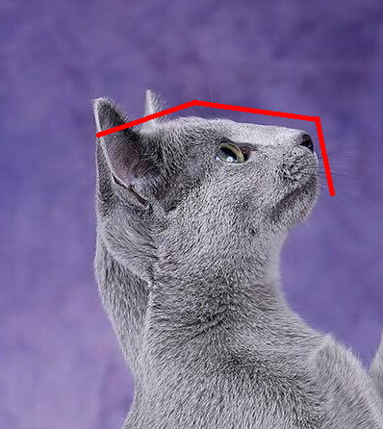
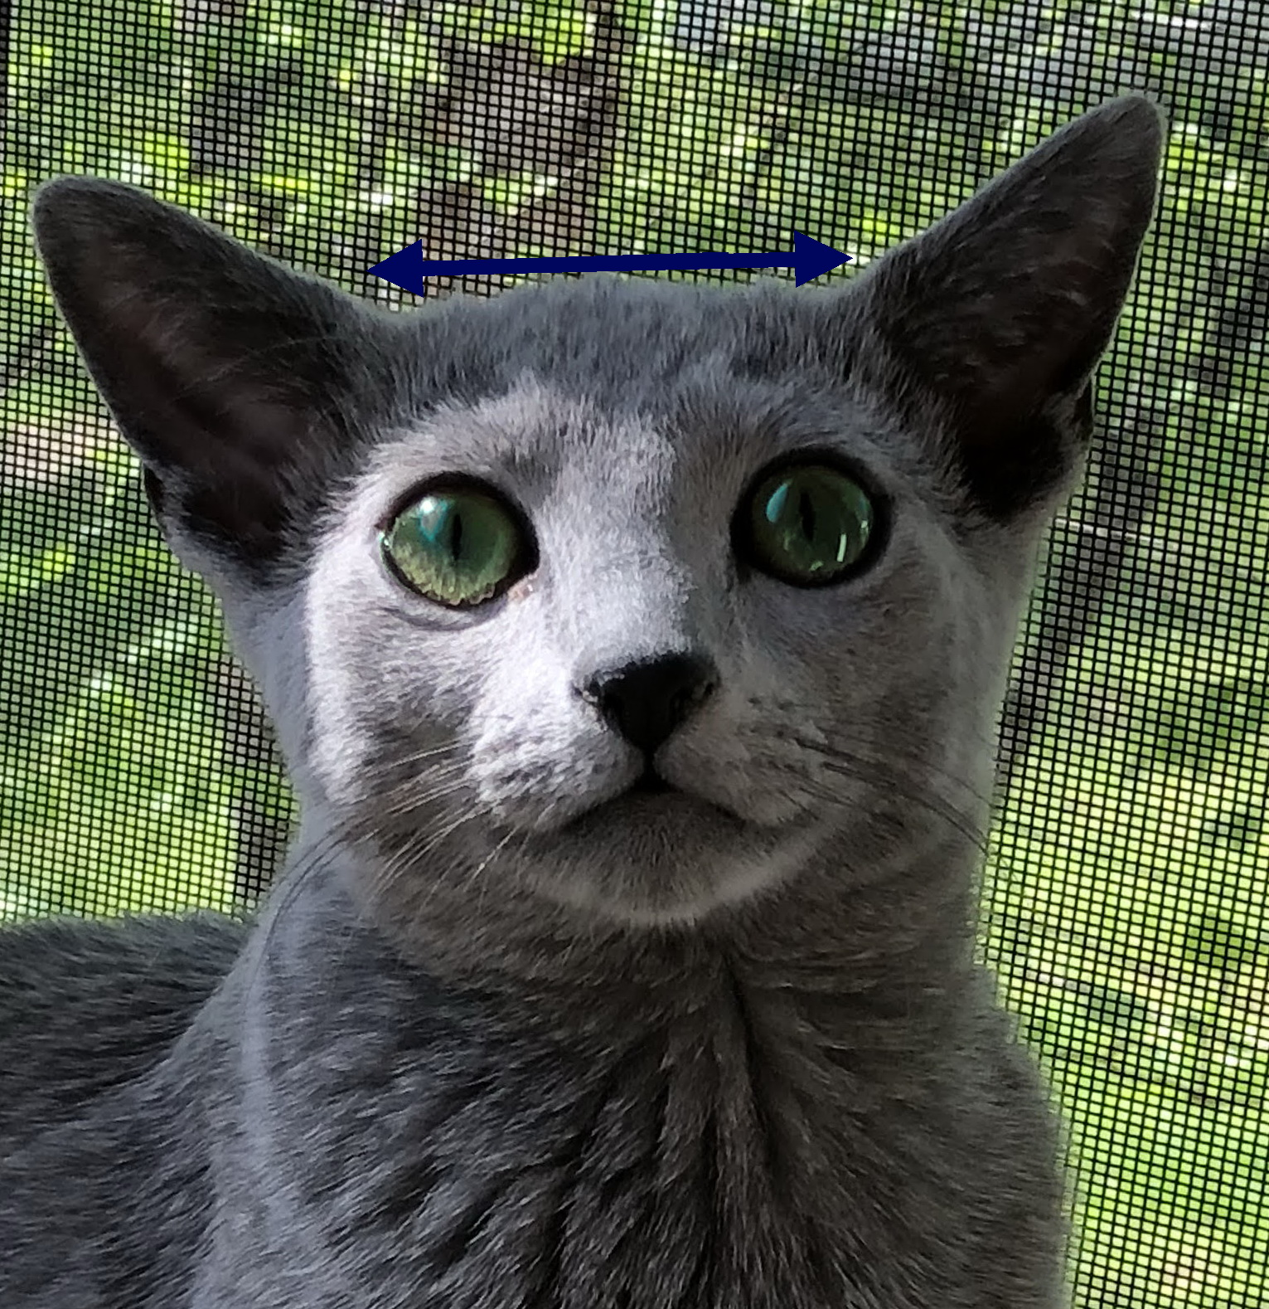
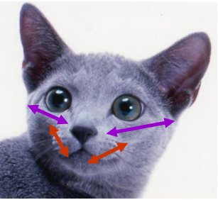
HEAD 25 Points
Full face: Medium wedge. Muzzle is blunt and forms part of total wedge without exaggerated pinch or whisker break. Face is broad across eyes due to wide eye set and thick fur at side of head.
Profile: Top of skull flat and long, gently descending to slightly below eyes and continuing at a downward angle in a straight line to tip of nose. No nose break or stop. High forehead.
No nose break or stop

Slide 6
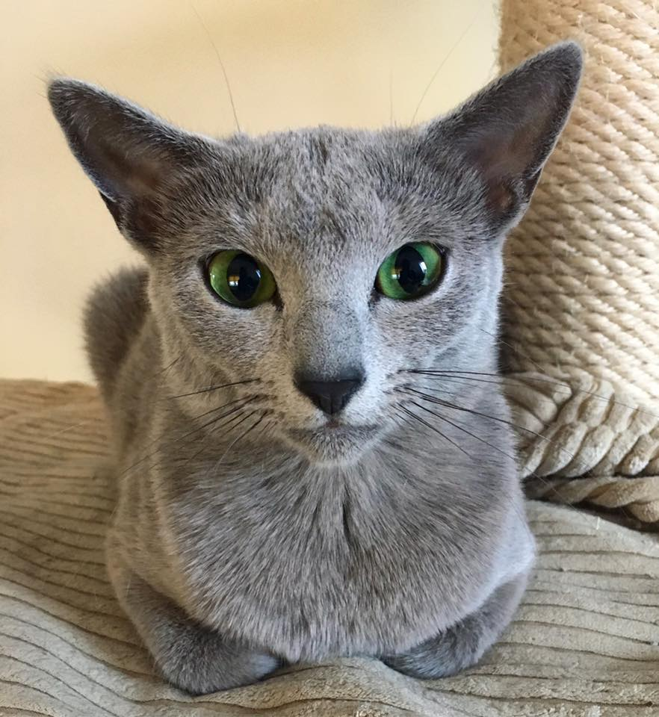
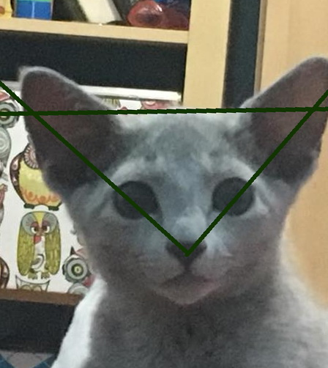
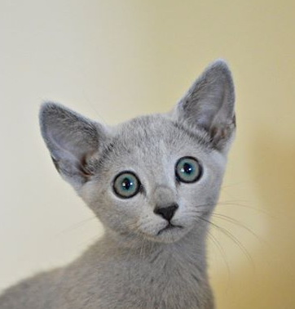
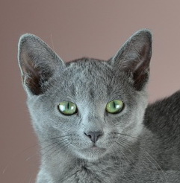
HEAD (continued)
Ears: Rather large and wide at base. Tips are more pointed than rounded. Skin on ears is thin and translucent with little inside furnishings. Outside of ear scantily covered with short, very fine hair, with leather showing through. Set far apart as much on the side of the head as on the top of head.
Eyes: Almost round but oval enough to show slight oriental slant. Set at least 1 1/2 eye widths apart.
Ears narrow at base; Eyes are too pointed
Bottom line of the ear is longer than top line
Oval eye shape; Ears are too high

Slide 7
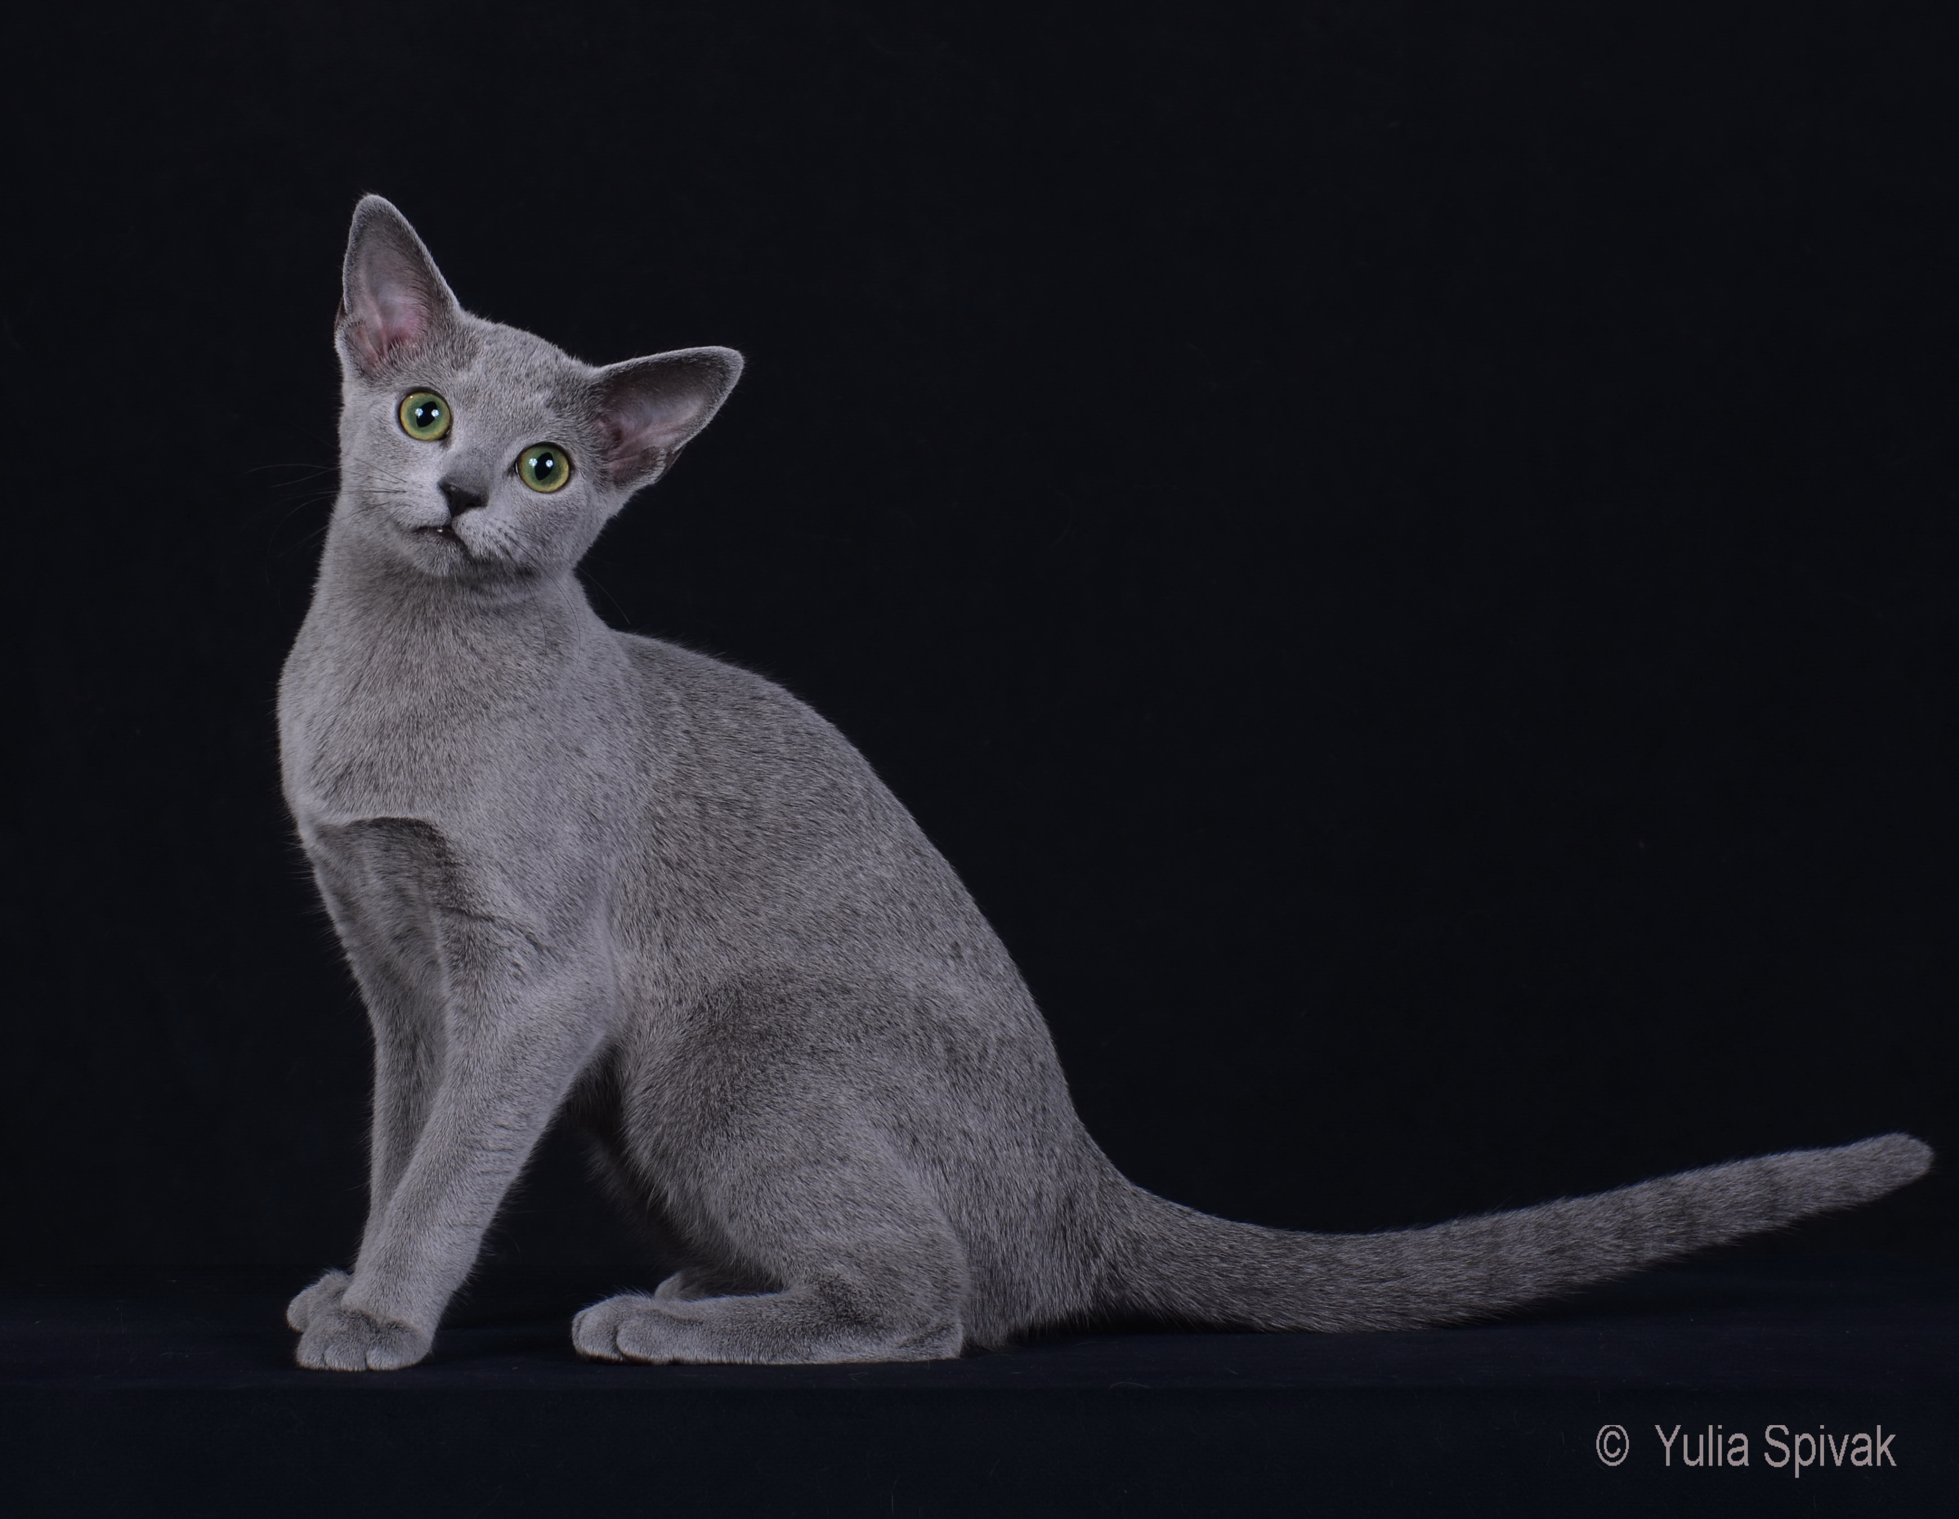
COAT TEXTURE/LENGTH 25 Points
Double coat. Short, dense, fine and plush-like. It stands out from body due to thick undercoat (this may be felt best by stroking the head).

Slide 8
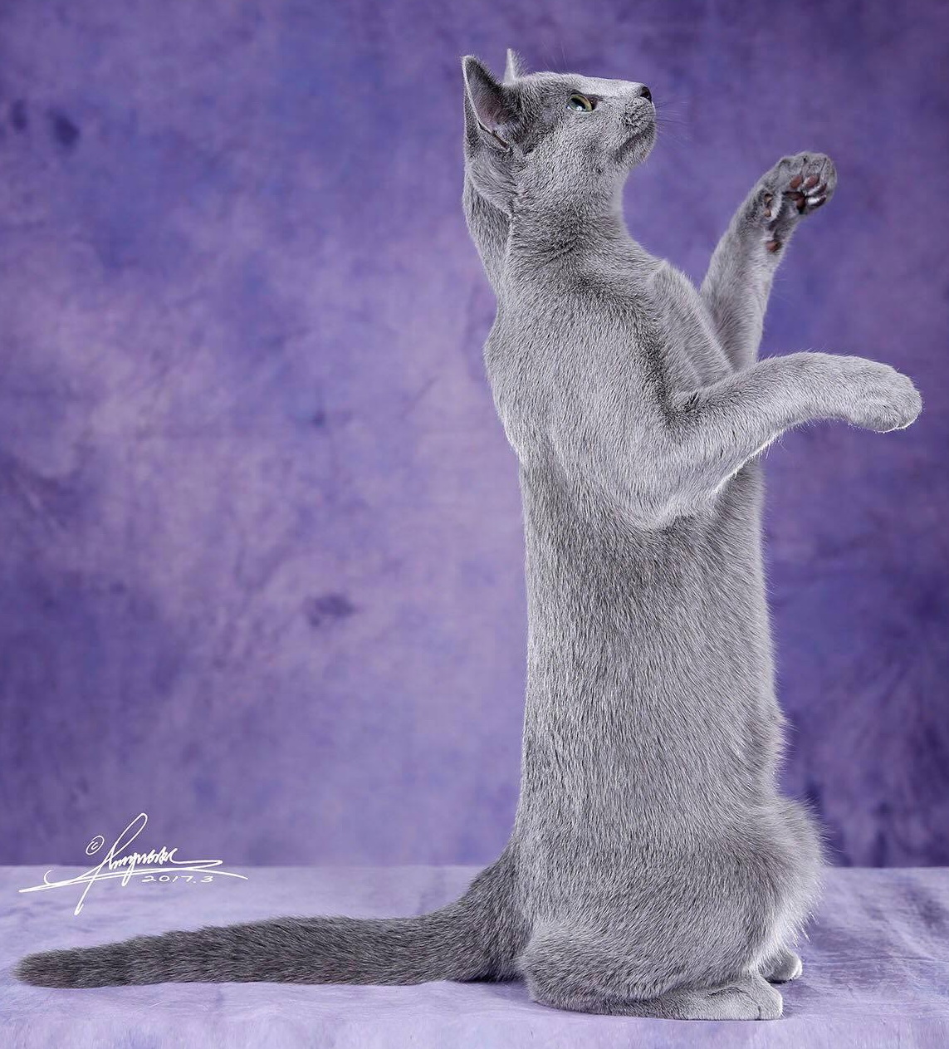
COLOUR 30 Points
Coat Color: Even bright blue throughout. Lighter shades preferred. Guard hairs distinctly silver-tipped giving a silvery sheen or lustrous appearance. Nose leather slate grey. Paw pads lavender pink or mauve.
Eye Color: Emerald green. Deep, even and brilliant. Kittens and adolescents have yellow eyes but by age of four months a green ring must be around each pupil.

Slide 9
CONDITION & BALANCE 5 Points
Musculature to be firm and well toned. Proper proportions and balance are more important than exact size.

Slide 10
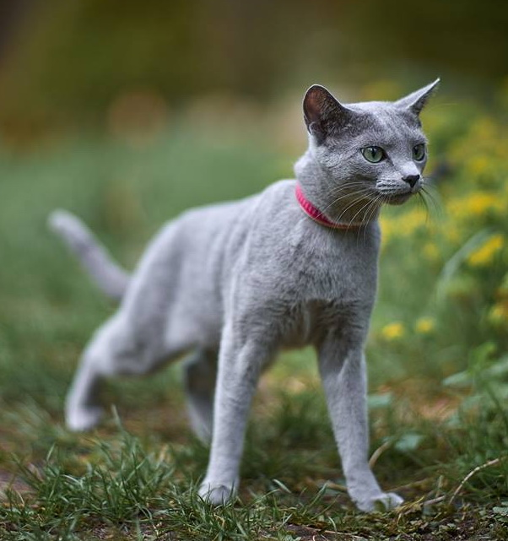
OBJECTIONS
Exaggerated pinch or whisker break. 1-3
Nose break or stop. 1-3
Dull eyes. 1-3
Lusterless coat. 1-3
DEDUCT

Slide 11
Handling
Prefer all four feet on the ground (security)
Will often respond to a kind voice
Russian Blues have strong feline instincts:
Facing another cat while going in/out of the judging cage may be a recipe for difficulties.
Hard to bluff—may not let you try more than once to get them out of the judging cage.
Enjoy a feather or other toys, but may be startled by or fearful of large/noisy teasers.

Slide 12
THANK YOU for your interest and attention!

Slide 13
Quiz
(the idea and execution - Amanda Bright)
Each of the following slides has a picture
Discuss the picture
When finished, click to compare analyses

Slide 14
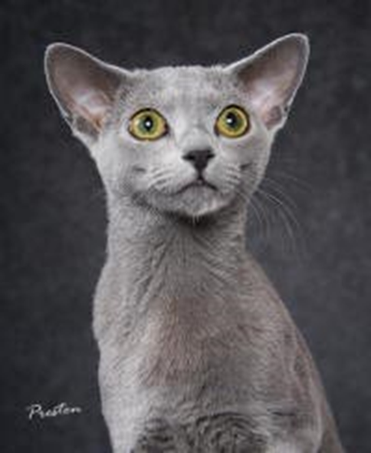
Quiz

Slide 15
Quiz

Slide 16
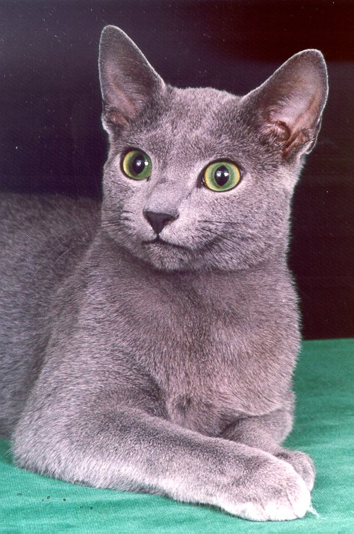
Quiz

Slide 17
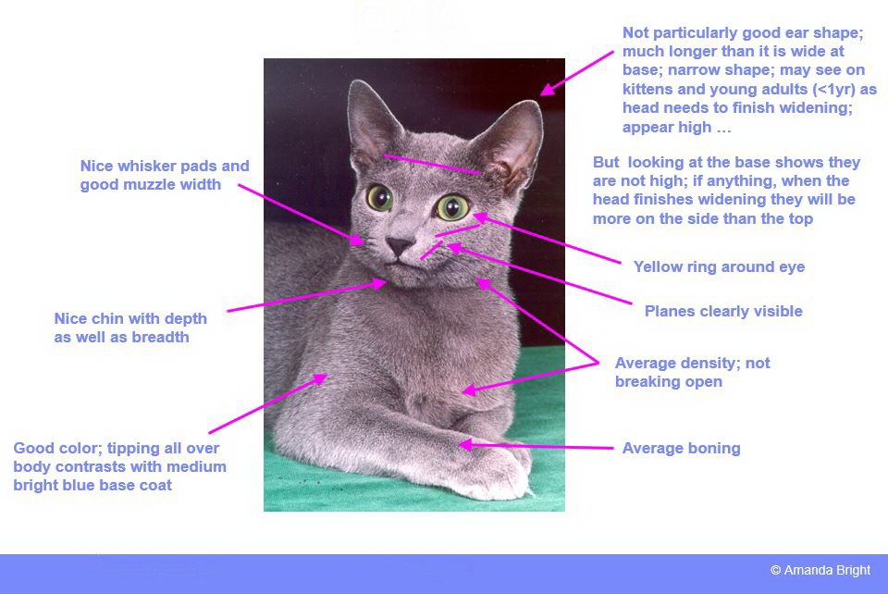
Quiz

Slide 18
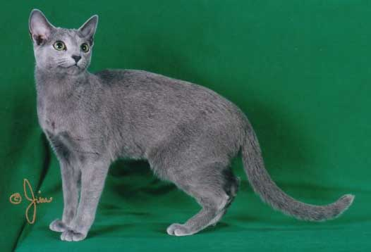
Quiz

Slide 19
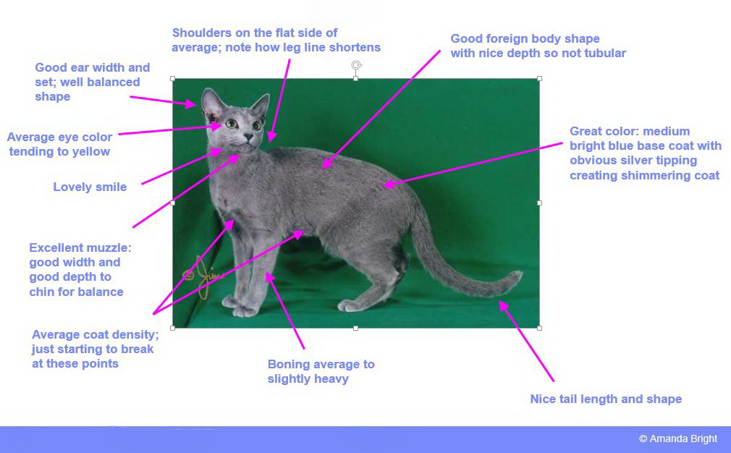
Quiz

Slide 20
Thanks to Annette Wilson and Amanda Bright for advising.
For more information and a comparison of standards, please see the CFA and the TICA presentations
CCA: silvershinerb.wixsite.com/russianblue/CCARussianBlue.pptx
CFA: cfa.org/Portals/0/documents/judges-ce/RussianBlue.pdf
TIKA: russianblues.ca/TICA_Seminars/russian_blue_judges.ppt

